Slide 1
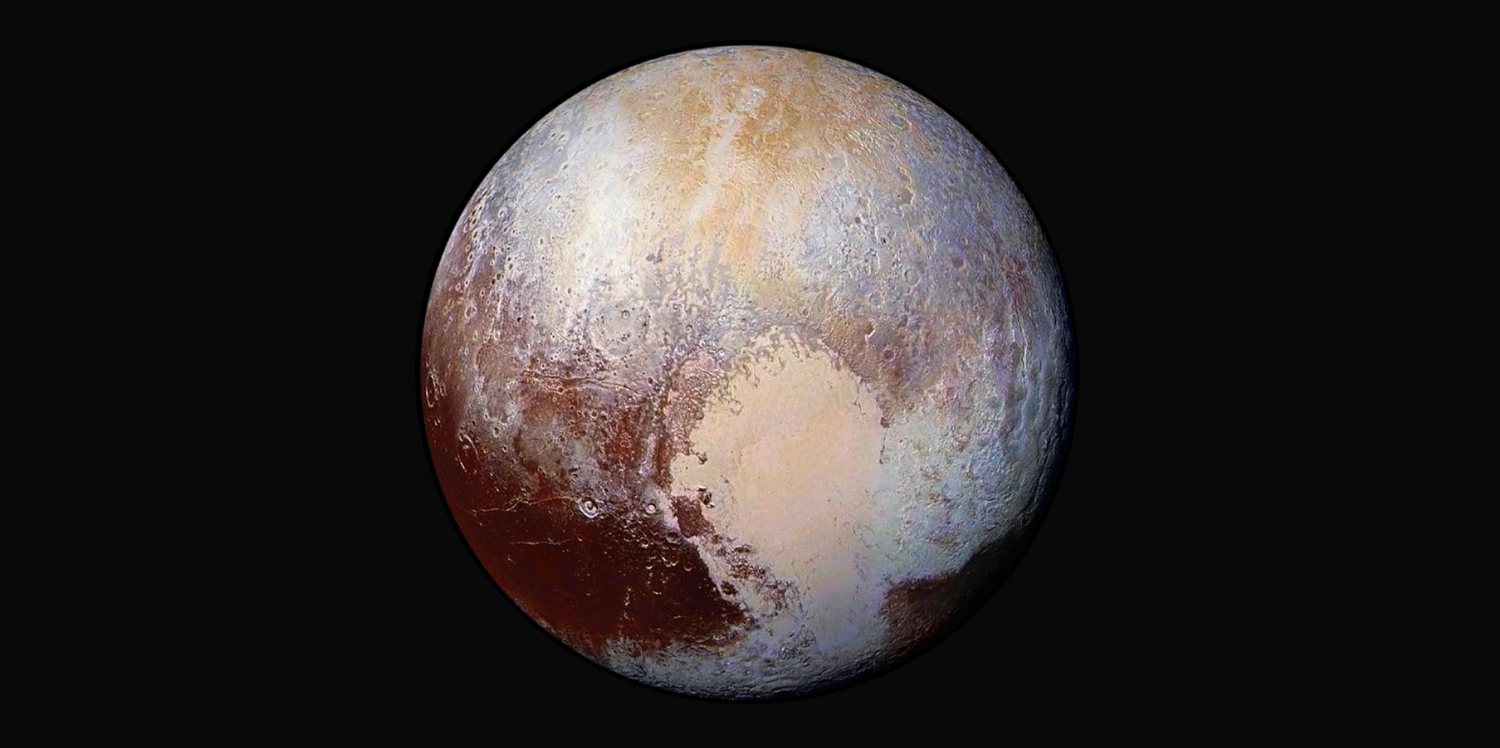
JVSRP Final Presentation
Lorenzo Feruglio, PhD student, Politecnico di Torino
Mentors: Alessandra Babuscia, Kar-Ming Cheung
332-H

Slide 2
Outline
Introduction & about me
Main research project
Interplanetary CubeSat Asteroid Mission
Preliminary Design for an Interplanetary CubeSat Mission
Payload Data Selection and event recognition
Failure detection
Secondary projects:
Inflatable Antenna
Small Satellite Mission Database

Slide 3
Introduction
About me
PhD student, Aerospace Engineering
Background: Systems Engineering
Field of research: Small Satellite Mission Autonomy
Current year tasks objectives: explore and realize prototypes to evaluate the behavior and performances of the most promising Artificial Intelligence algorithms for a space mission
The research carried on at JPL reflects the current tasks objectives
Three directions have been followed:
Tradespace exploration with genetic algorithms
Payload data selection and event recognition with neural networks
Failure detection using fuzzy logics

Slide 4
COPINS
Cubesat Opportunity Payload Intersatellite Network Sensors

Slide 5
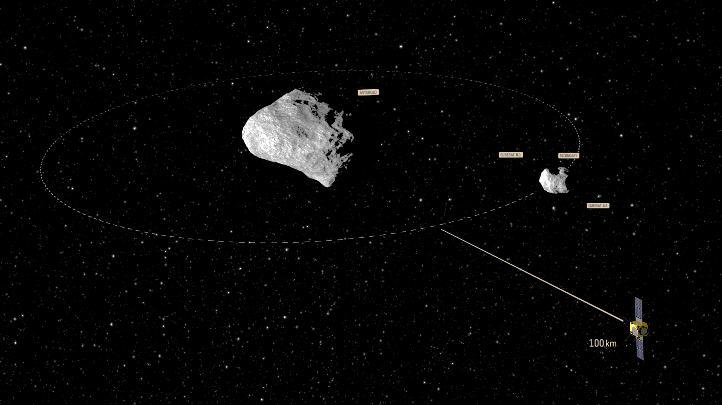
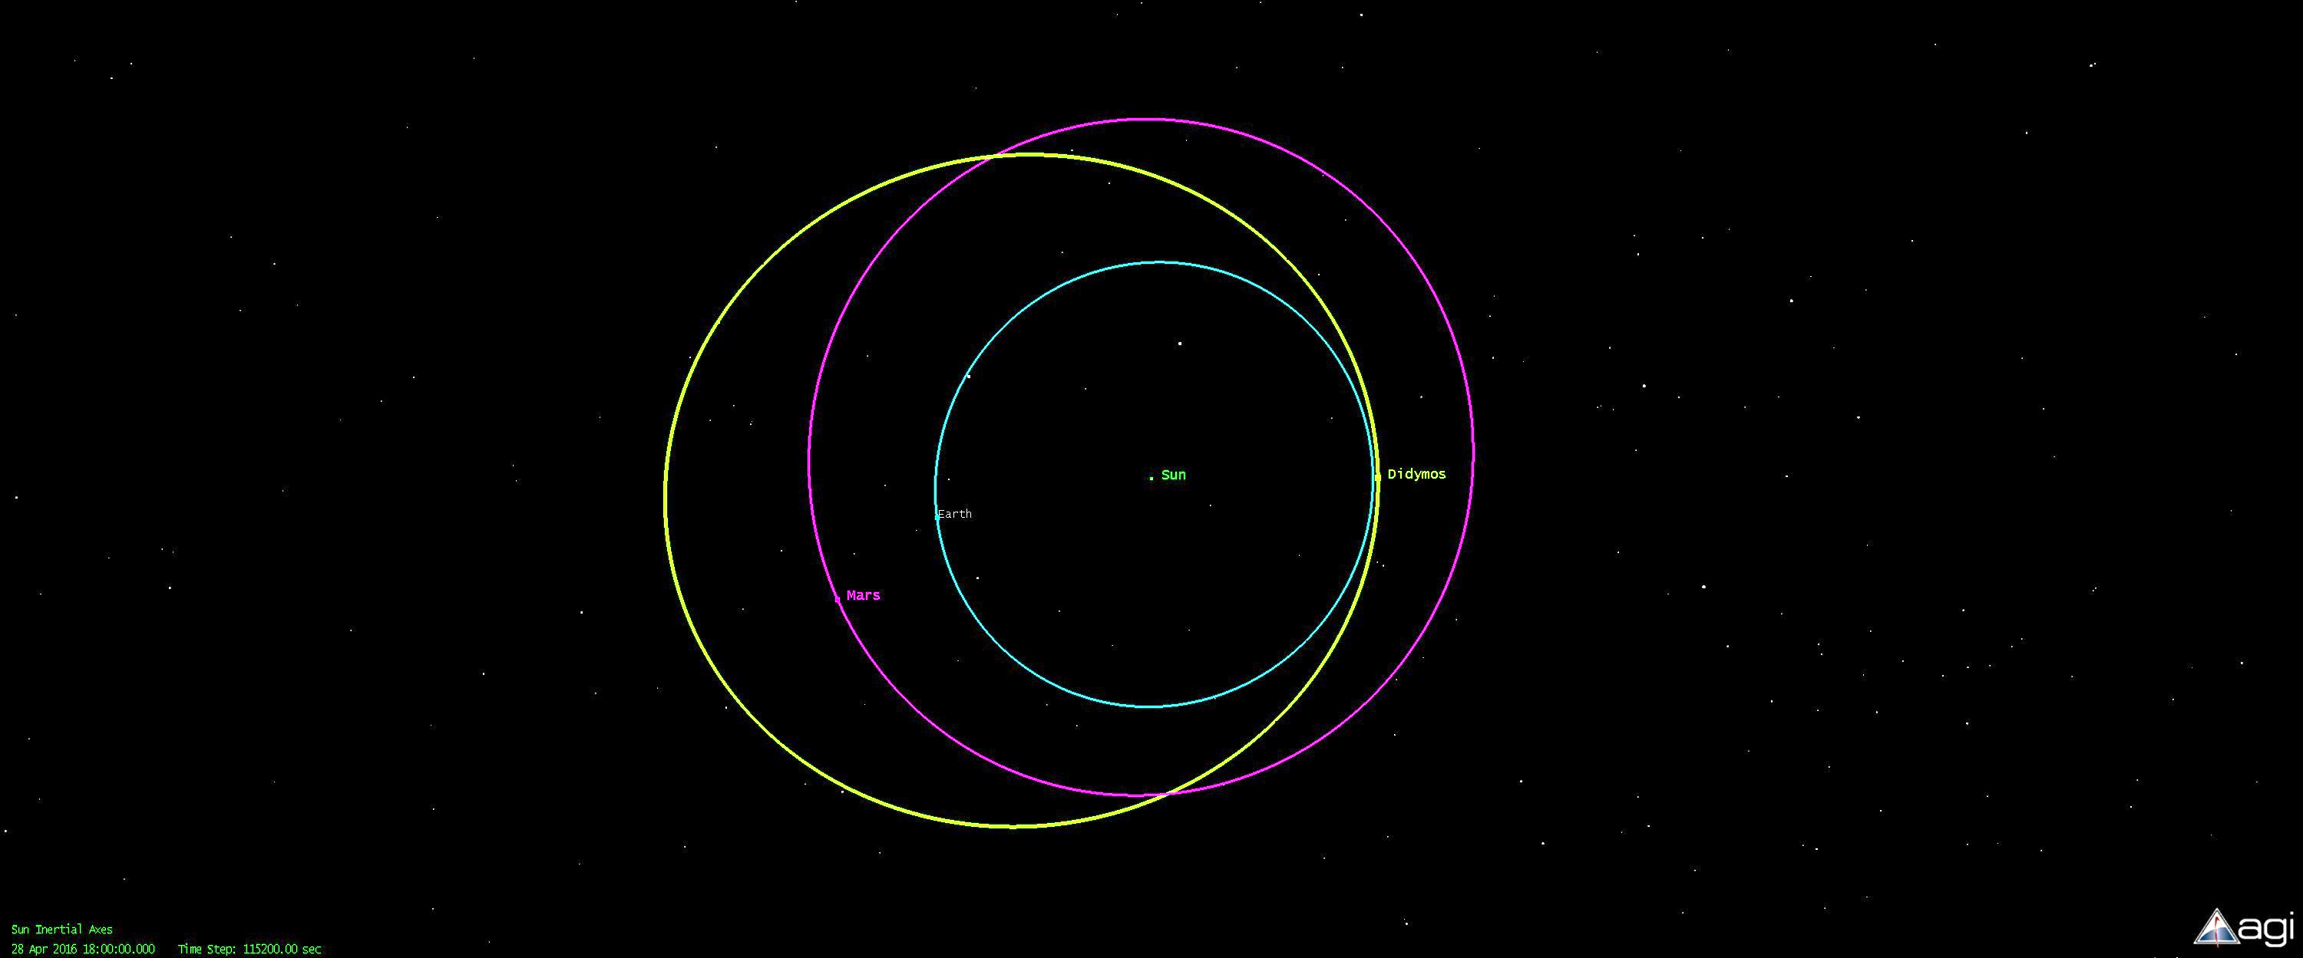
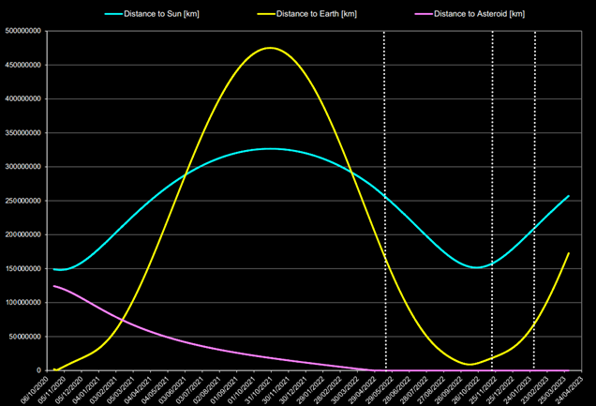
Context
Reference mission
Didymos system
Apollo group
Binary asteroid (diameters: 800m primary, 150m secondary)
Selected as target for the AIDA mission:
DART: impactor spacecraft (NASA)
AIM: monitoring spacecraft (ESA) (A/B1 kickoff: March 2015)
Objectives:
Asteroid deflection, asteroid characterization
AIM Payload:
Two 3U CubeSats (30x10x10cm)
Support to AIM, increase science return, technology demonstration

Slide 6
Objectives of the collaboration
Analysis of mission concepts, focusing on CubeSats as secondary payload
Review of literature
Analysis of mission scenarios
Communication architectures
Design budgets
mass, power, link, propulsion, cost budgets
Selection of a mission concept
Open source

Slide 7
Initial Considerations
Flexible environment:
Growing selection of components
COTS are the main option
Increasing availability of space qualified components
Stakeholder needs are also TBD
Increased science return, technological demonstration
Open for proposal
Uncertainties:
What is the budget for the CubeSats?
How do we pick a mission concept?
How much can we push the limits on the system capabilities?
Which components do we use?
How do we decide on mission-level trade-offs?
How good will the chosen design satisfy the stakeholders?

Slide 8
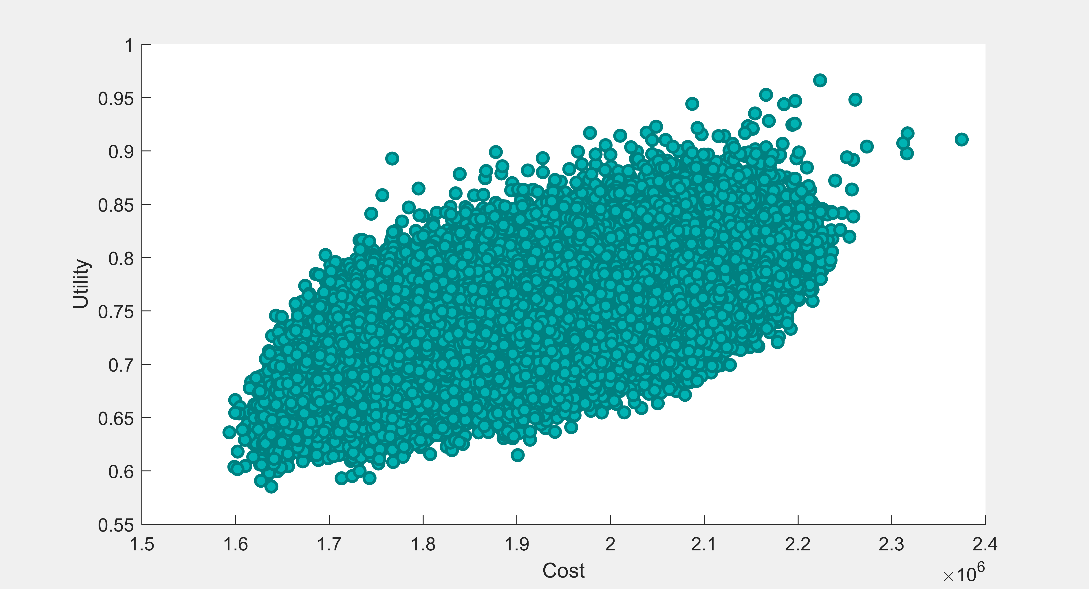
Tradespace Exploration Problem I
Can we analyze this as a tradespace exploration problem?
Design vectors

Slide 9
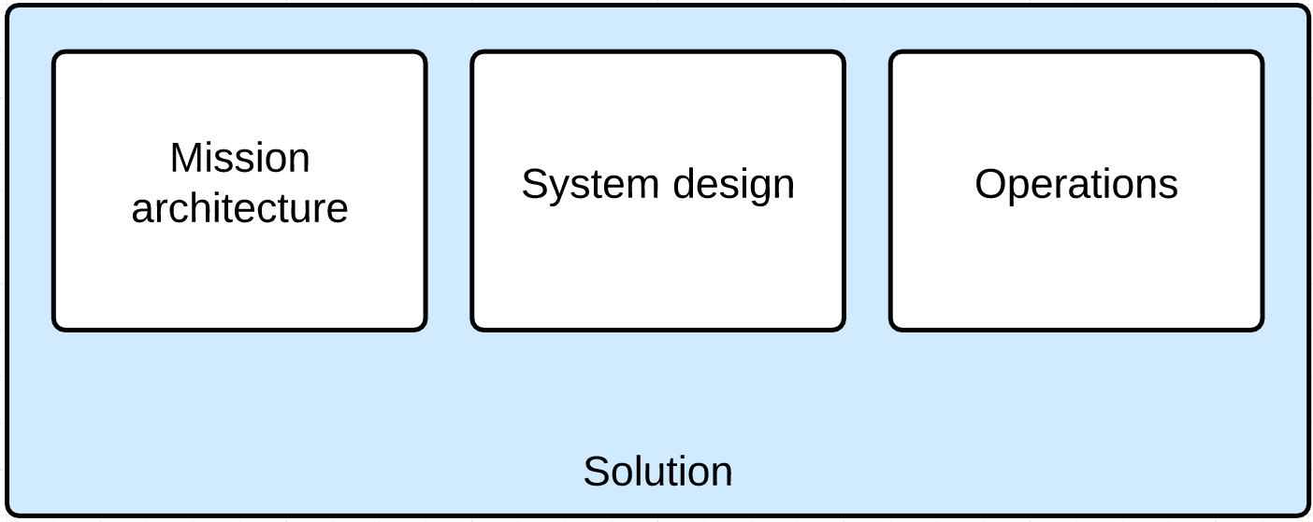
Tradespace Exploration Problem II
Can we analyze this as a tradespace exploration problem?
Solutions characteristics
As close as possible to a full mission concept
Mission architecture, operations and system aspects

Slide 10
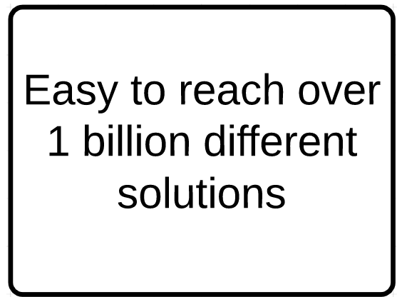
Tradespace Exploration Problem II
Can we analyze this as a tradespace exploration problem?
Solutions characteristics
As close as possible to a full mission concept
Mission architecture, operations and system aspects
Computational problem
More details bring more variables
Design vector explodes quickly
CubeSats database
Multitude of components available
Unfeasible to evaluate all the possible designs

Slide 11
Tradespace Exploration Problem II
Can we analyze this as a tradespace exploration problem?
Solutions characteristics
As close as possible to a full mission concept
Mission architecture, operations and system aspects
Computational problem
More details bring more variables
Design vector explodes quickly
CubeSats database
Multitude of components available
Unfeasible to evaluate all the possible designs
Concurrent Design is needed
Can we create an algorithm for concurrent design as a result of the tradespace exploration?

Slide 12
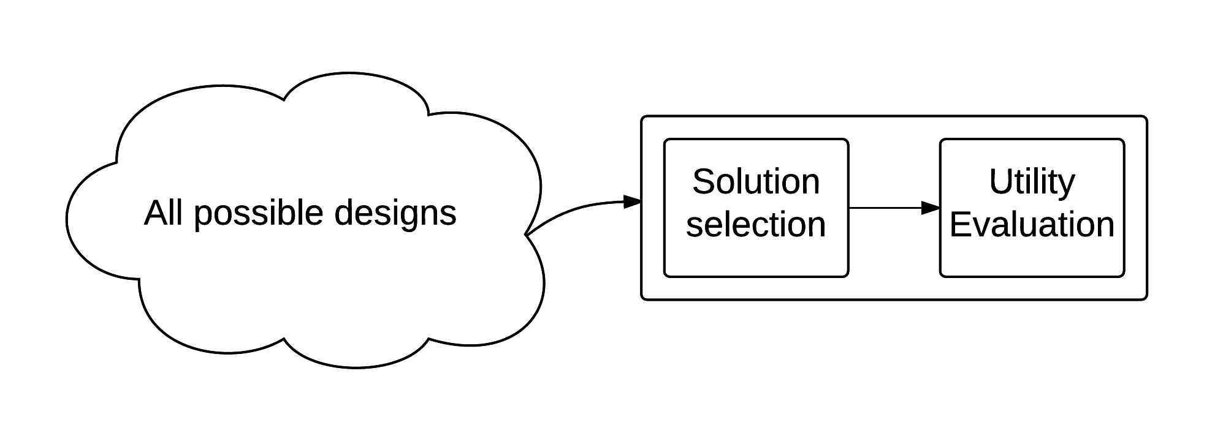
Tradespace Exploration Problem III
Basic setup

Slide 13
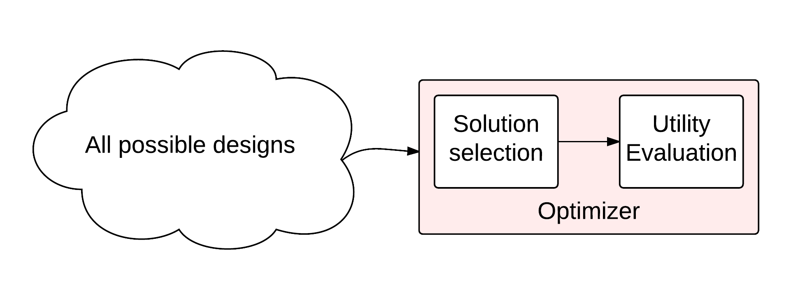
Tradespace Exploration Problem III
For problems with a great amount of solutions, we add an optimizer

Slide 14
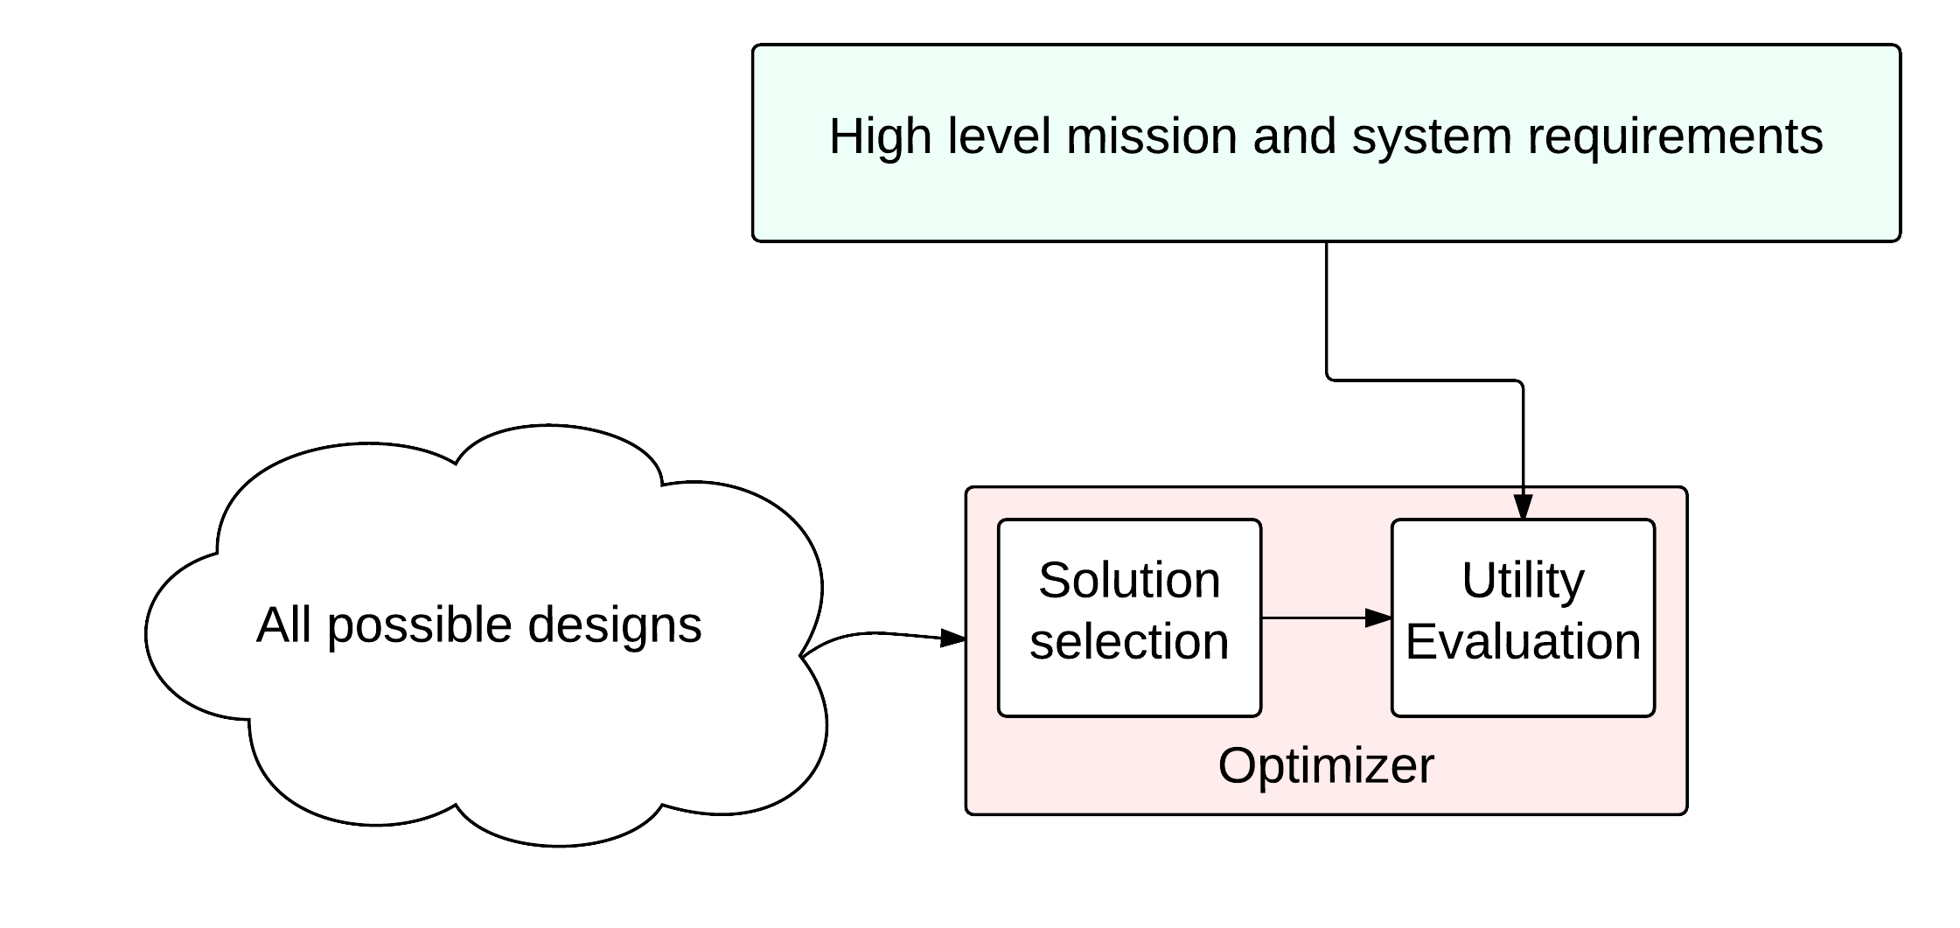
Tradespace Exploration Problem III
Can we consider the mission and system requirements when evaluating a solution?

Slide 15
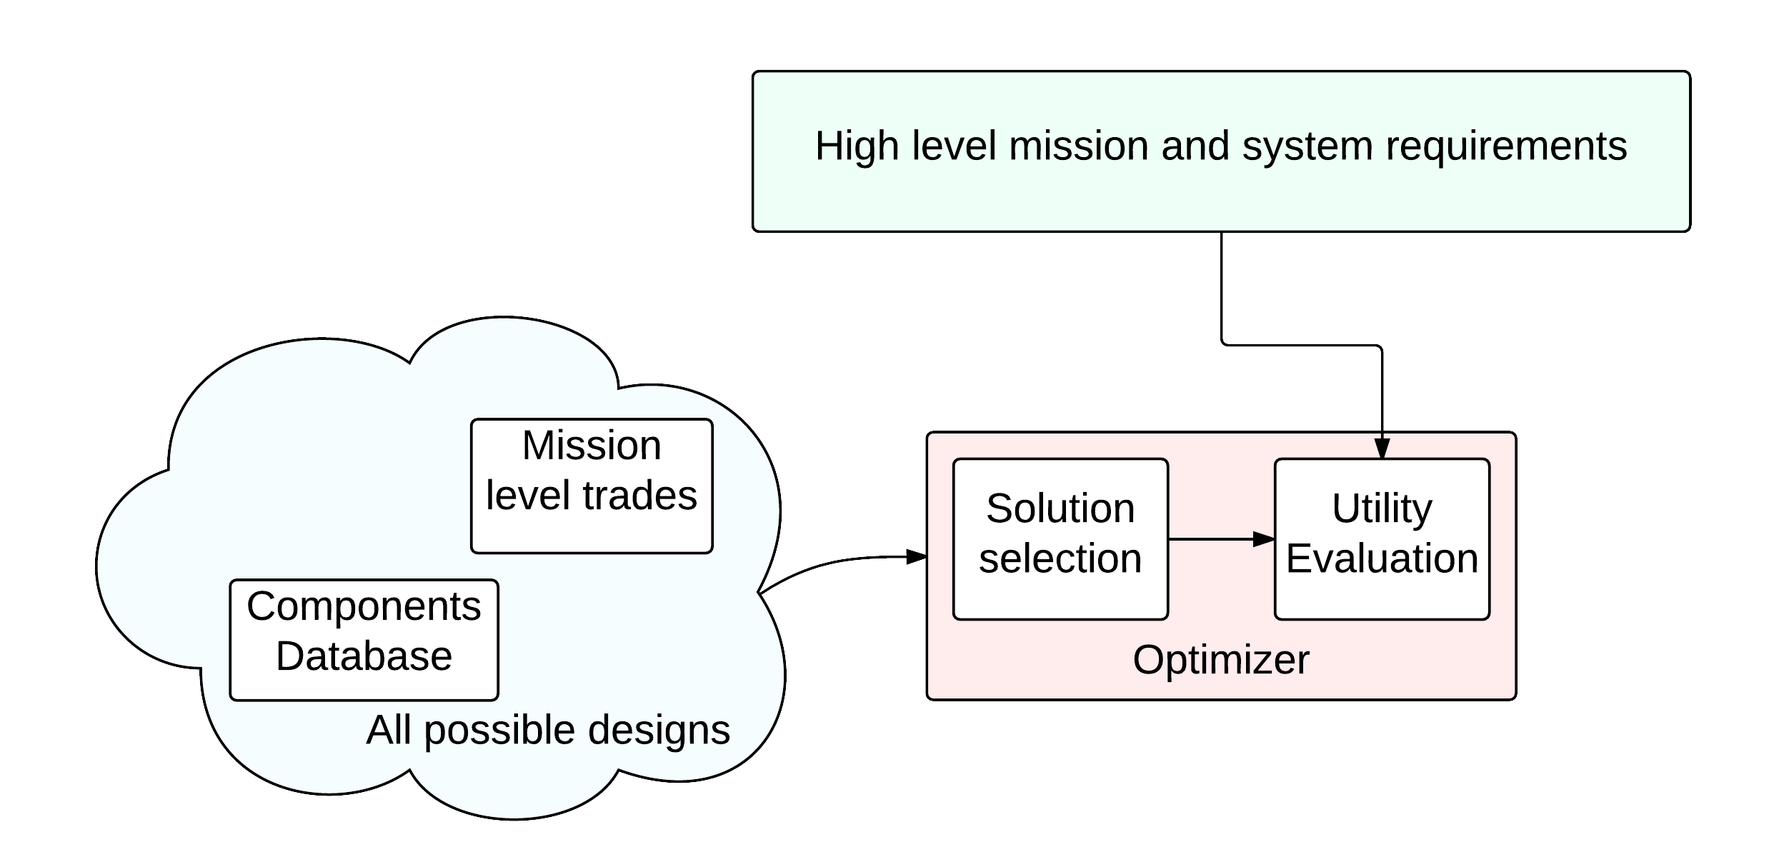
Tradespace Exploration Problem III
Use a database from where to choose solution components

Slide 16
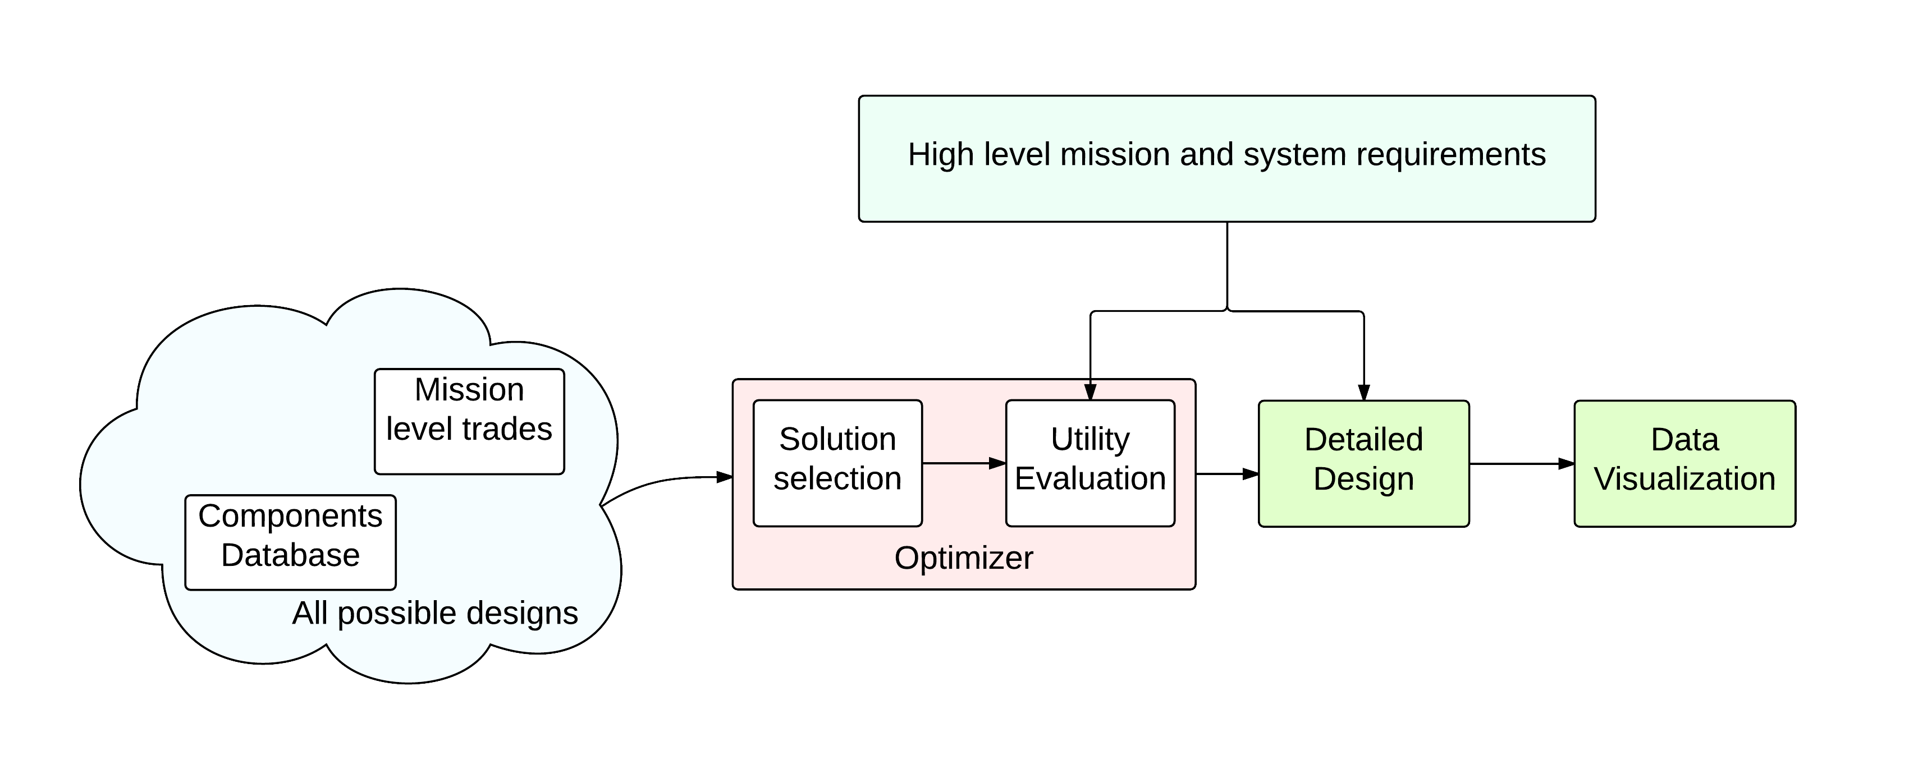
Tradespace Exploration Problem III
Adding system budgets and data visualization to the algorithm

Slide 17
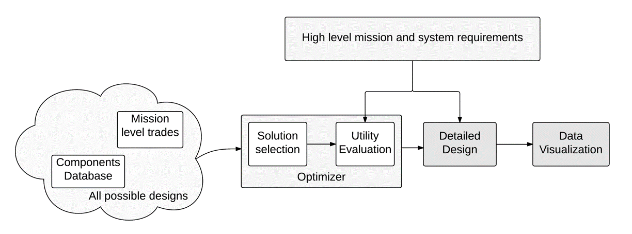
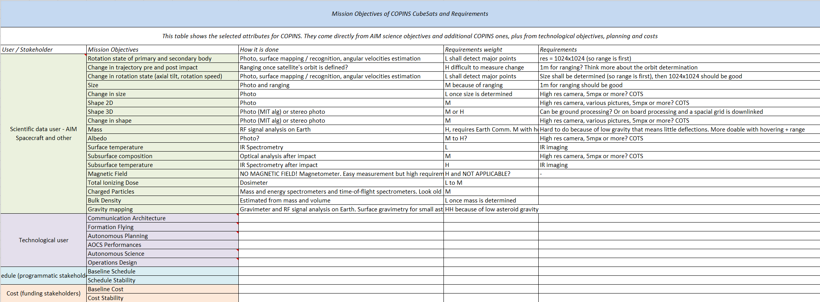
The Design Vector
How do we describe each solution? How can we include both mission and system level aspects in the solution?
Science traceability matrix
Input: STM
Output: DV and weights

Slide 18
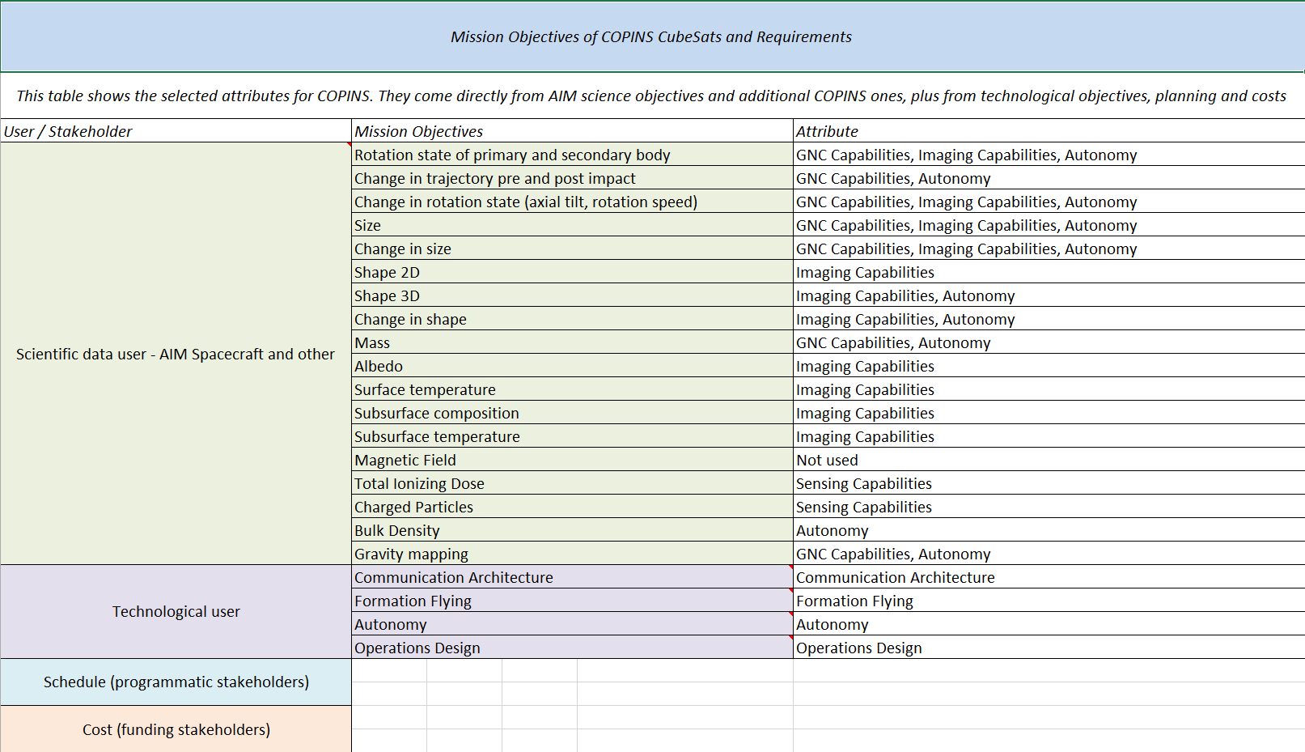
The Design Vector
From STM to the Design Vector
Science traceability matrix
Attributes definition
Input: STM
Each objective defines a sets of attributes that are involved
Output: DV and weights

Slide 19
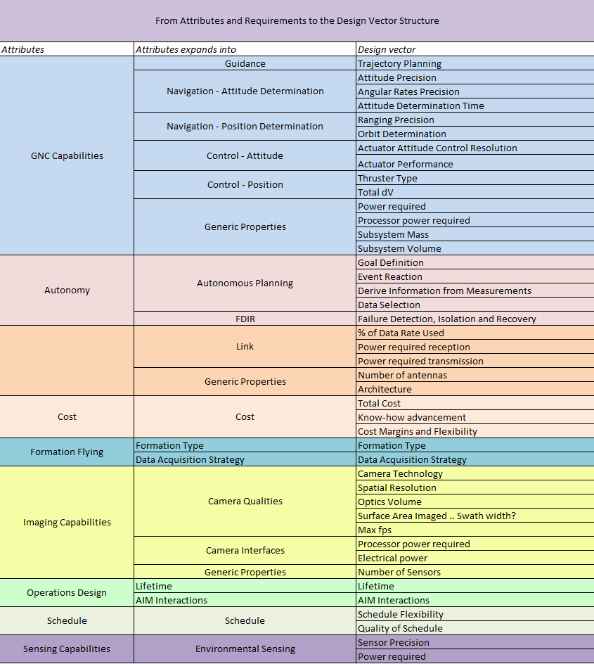
The Design Vector
From STM to the Design Vector
Science traceability matrix
Attributes definition
Expanding into the design vector
Input: STM
Each objective defines a sets of attributes that are involved
Each attribute expands into more detailed aspects
Output: DV and weights

Slide 20
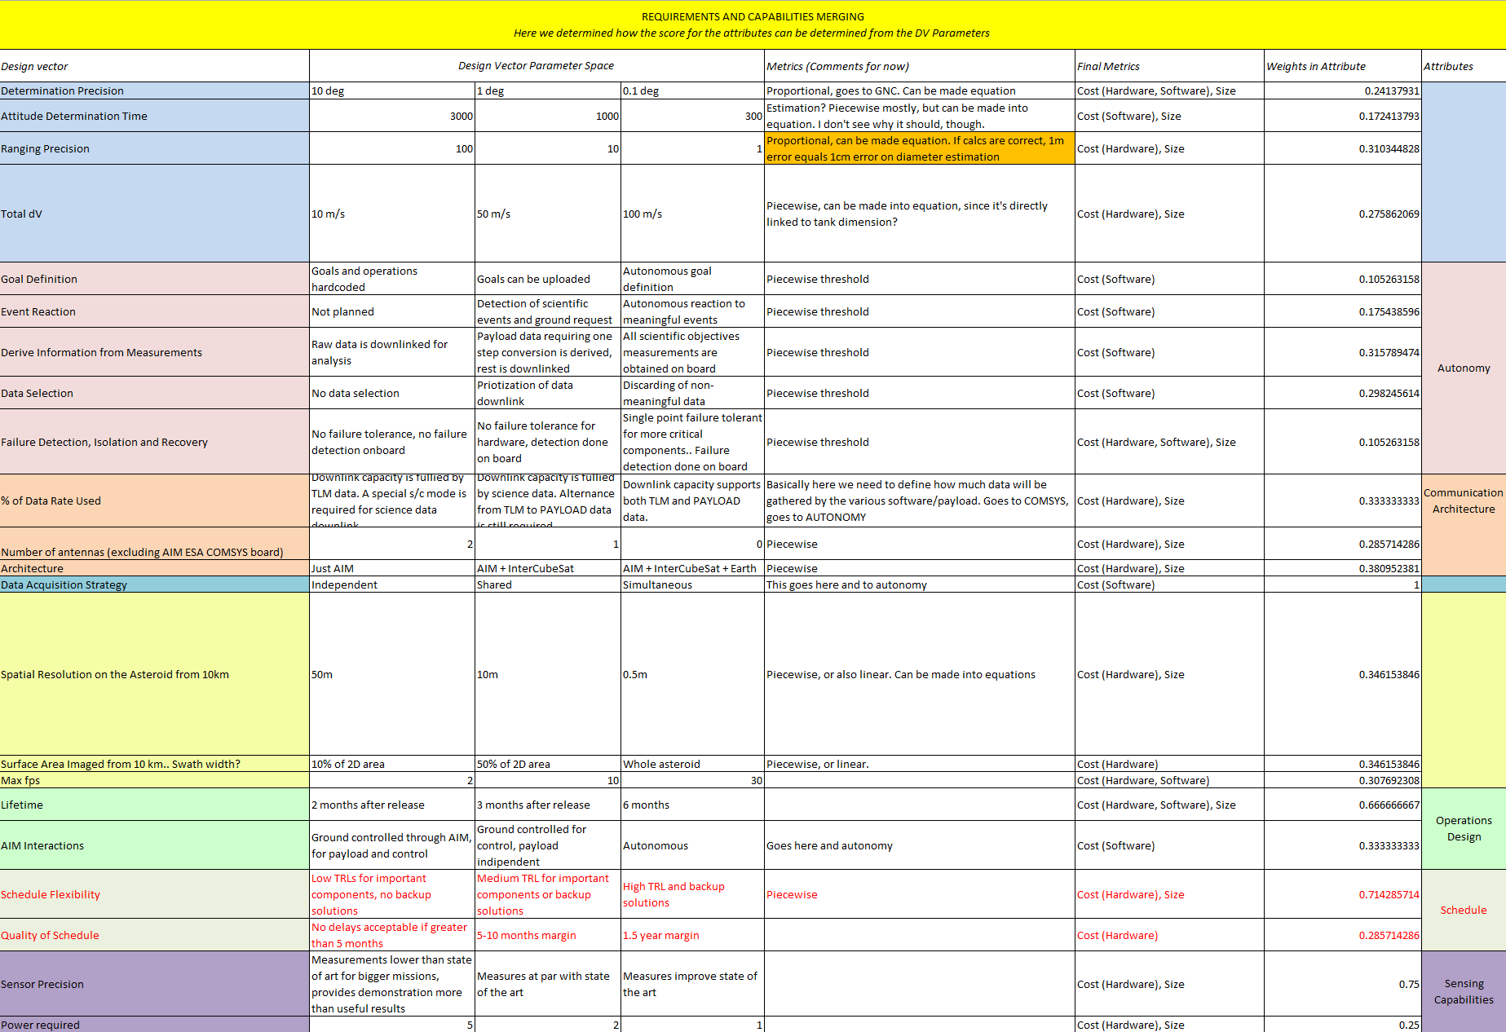
The Design Vector
From STM to the Design Vector
Science traceability matrix
Attributes definition
Expanding into the design vector
Input: STM
Each objective defines a sets of attributes that are involved
Each attribute expands into more detailed aspects
Attributes weights and metrics assessment
Output: DV and weights
Each of these aspects is ruled by a law, and this law influences the utility

Slide 21
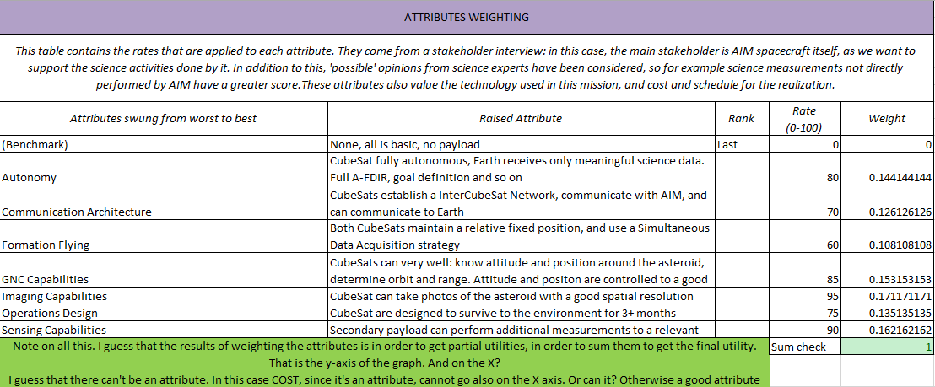
The Design Vector
From STM to the Design Vector
Science traceability matrix
Attributes definition
Expanding into the design vector
Input: STM
Each objective defines a sets of attributes that are involved
Each attribute expands into more detailed aspects
Attributes weights and metrics assessment
Output: DV and weights
Attributes evaluation
Each of these aspects is ruled by a law, and this law influences the utility
Finally, weights are applied to these aspects in order to obtain global utility

Slide 22
The Design Vector
How is our solution shaped?
Total: 22 elements
Total solution space: 12+ billions
Field | Parameter # | Equipment
Autonomy | 5 | -
Communication | 3 | Radio
Imaging Payload | 2 | Camera
Secondary Payload | - | Any in DB
GNC | 4 | Thrusters, RW
Data Acquisition | 1 | -
Operations | 2 | -

Slide 23
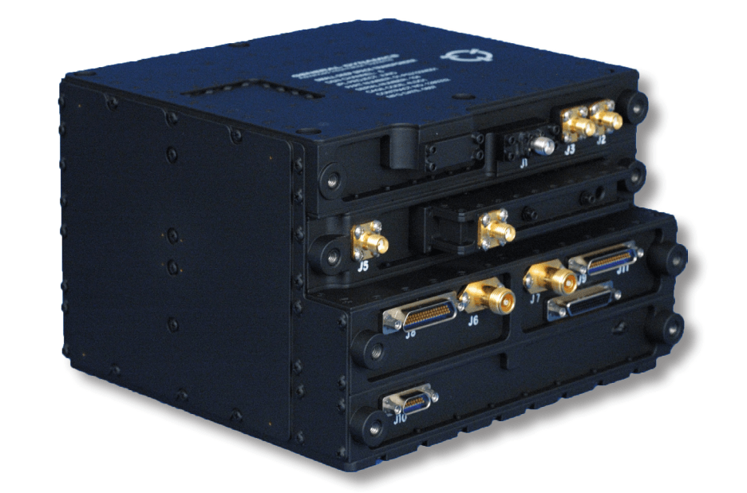
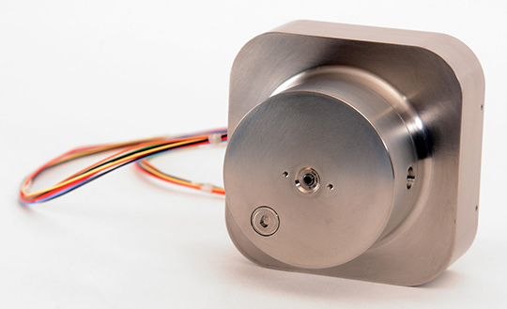
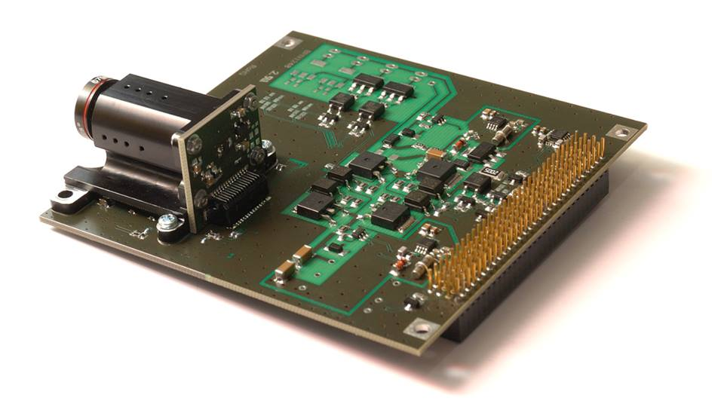
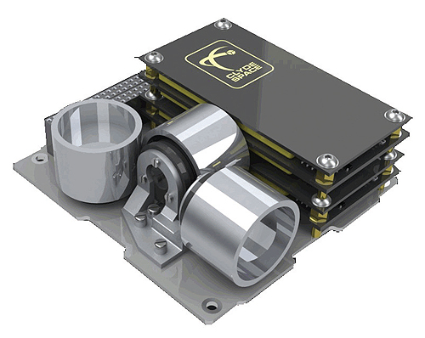
The Component Database
Defined in Matlab
Four mandatory parameters: mass, power, cost and size
Other parameters depending on the category
Compatible by design with the Small Satellite Database (JPL)

Slide 24

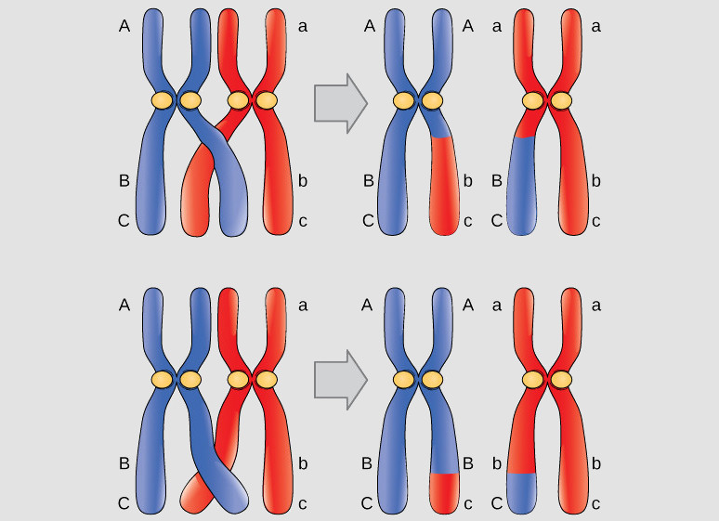
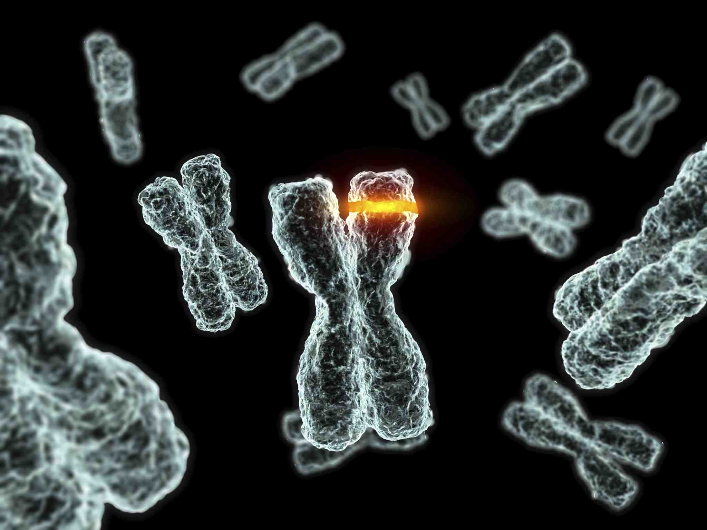
AI for Tradespace Exploration
Genetic Algorithms
Introducing a genetic algorithm to quickly explore all the possible design vectors
How it works
Emulates the behavior of living beings, especially the dynamics of population of individuals
Reproductive dynamics can be emulated by selecting the appropriate functions
Population initialization
Crossover
Mutation

Slide 25
AI for Tradespace Exploration II
Genetic Algorithms
Selected Characteristics
Individuals described by chromosomes of integer genes
22 gene dimension
12.3 billion individuals (solutions) explored
Custom creation, mutation and crossover functions were implemented
Initial population of 330
Simple crossover in a random point
Mutation rate 5%
Genetic Algorithm made of generational + elitism traits
Tournament selection
Elite population (15 individuals)
Infeasible solution
Violated requirements
Discarded and population re-initialized randomly for the remaining individuals
Stopping condition
Iteration number or tolerance threshold

Slide 26
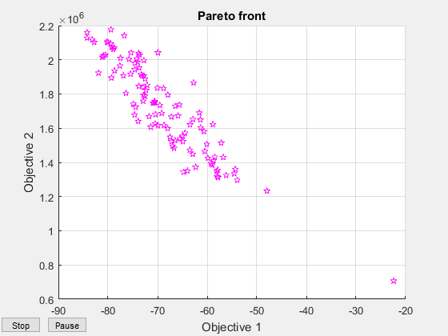
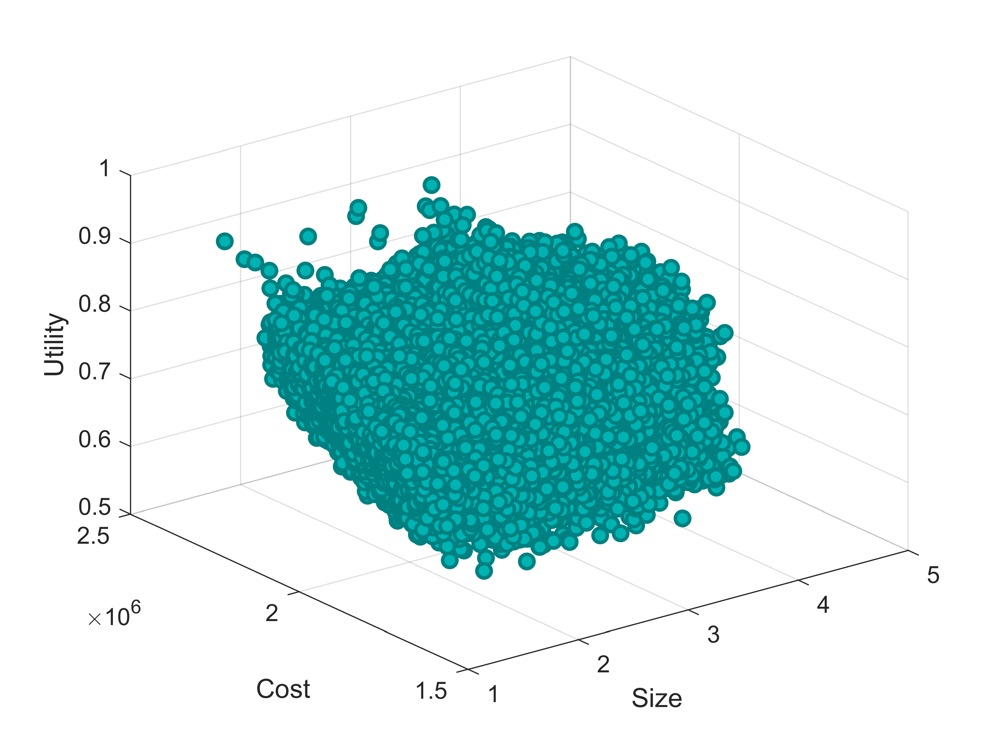
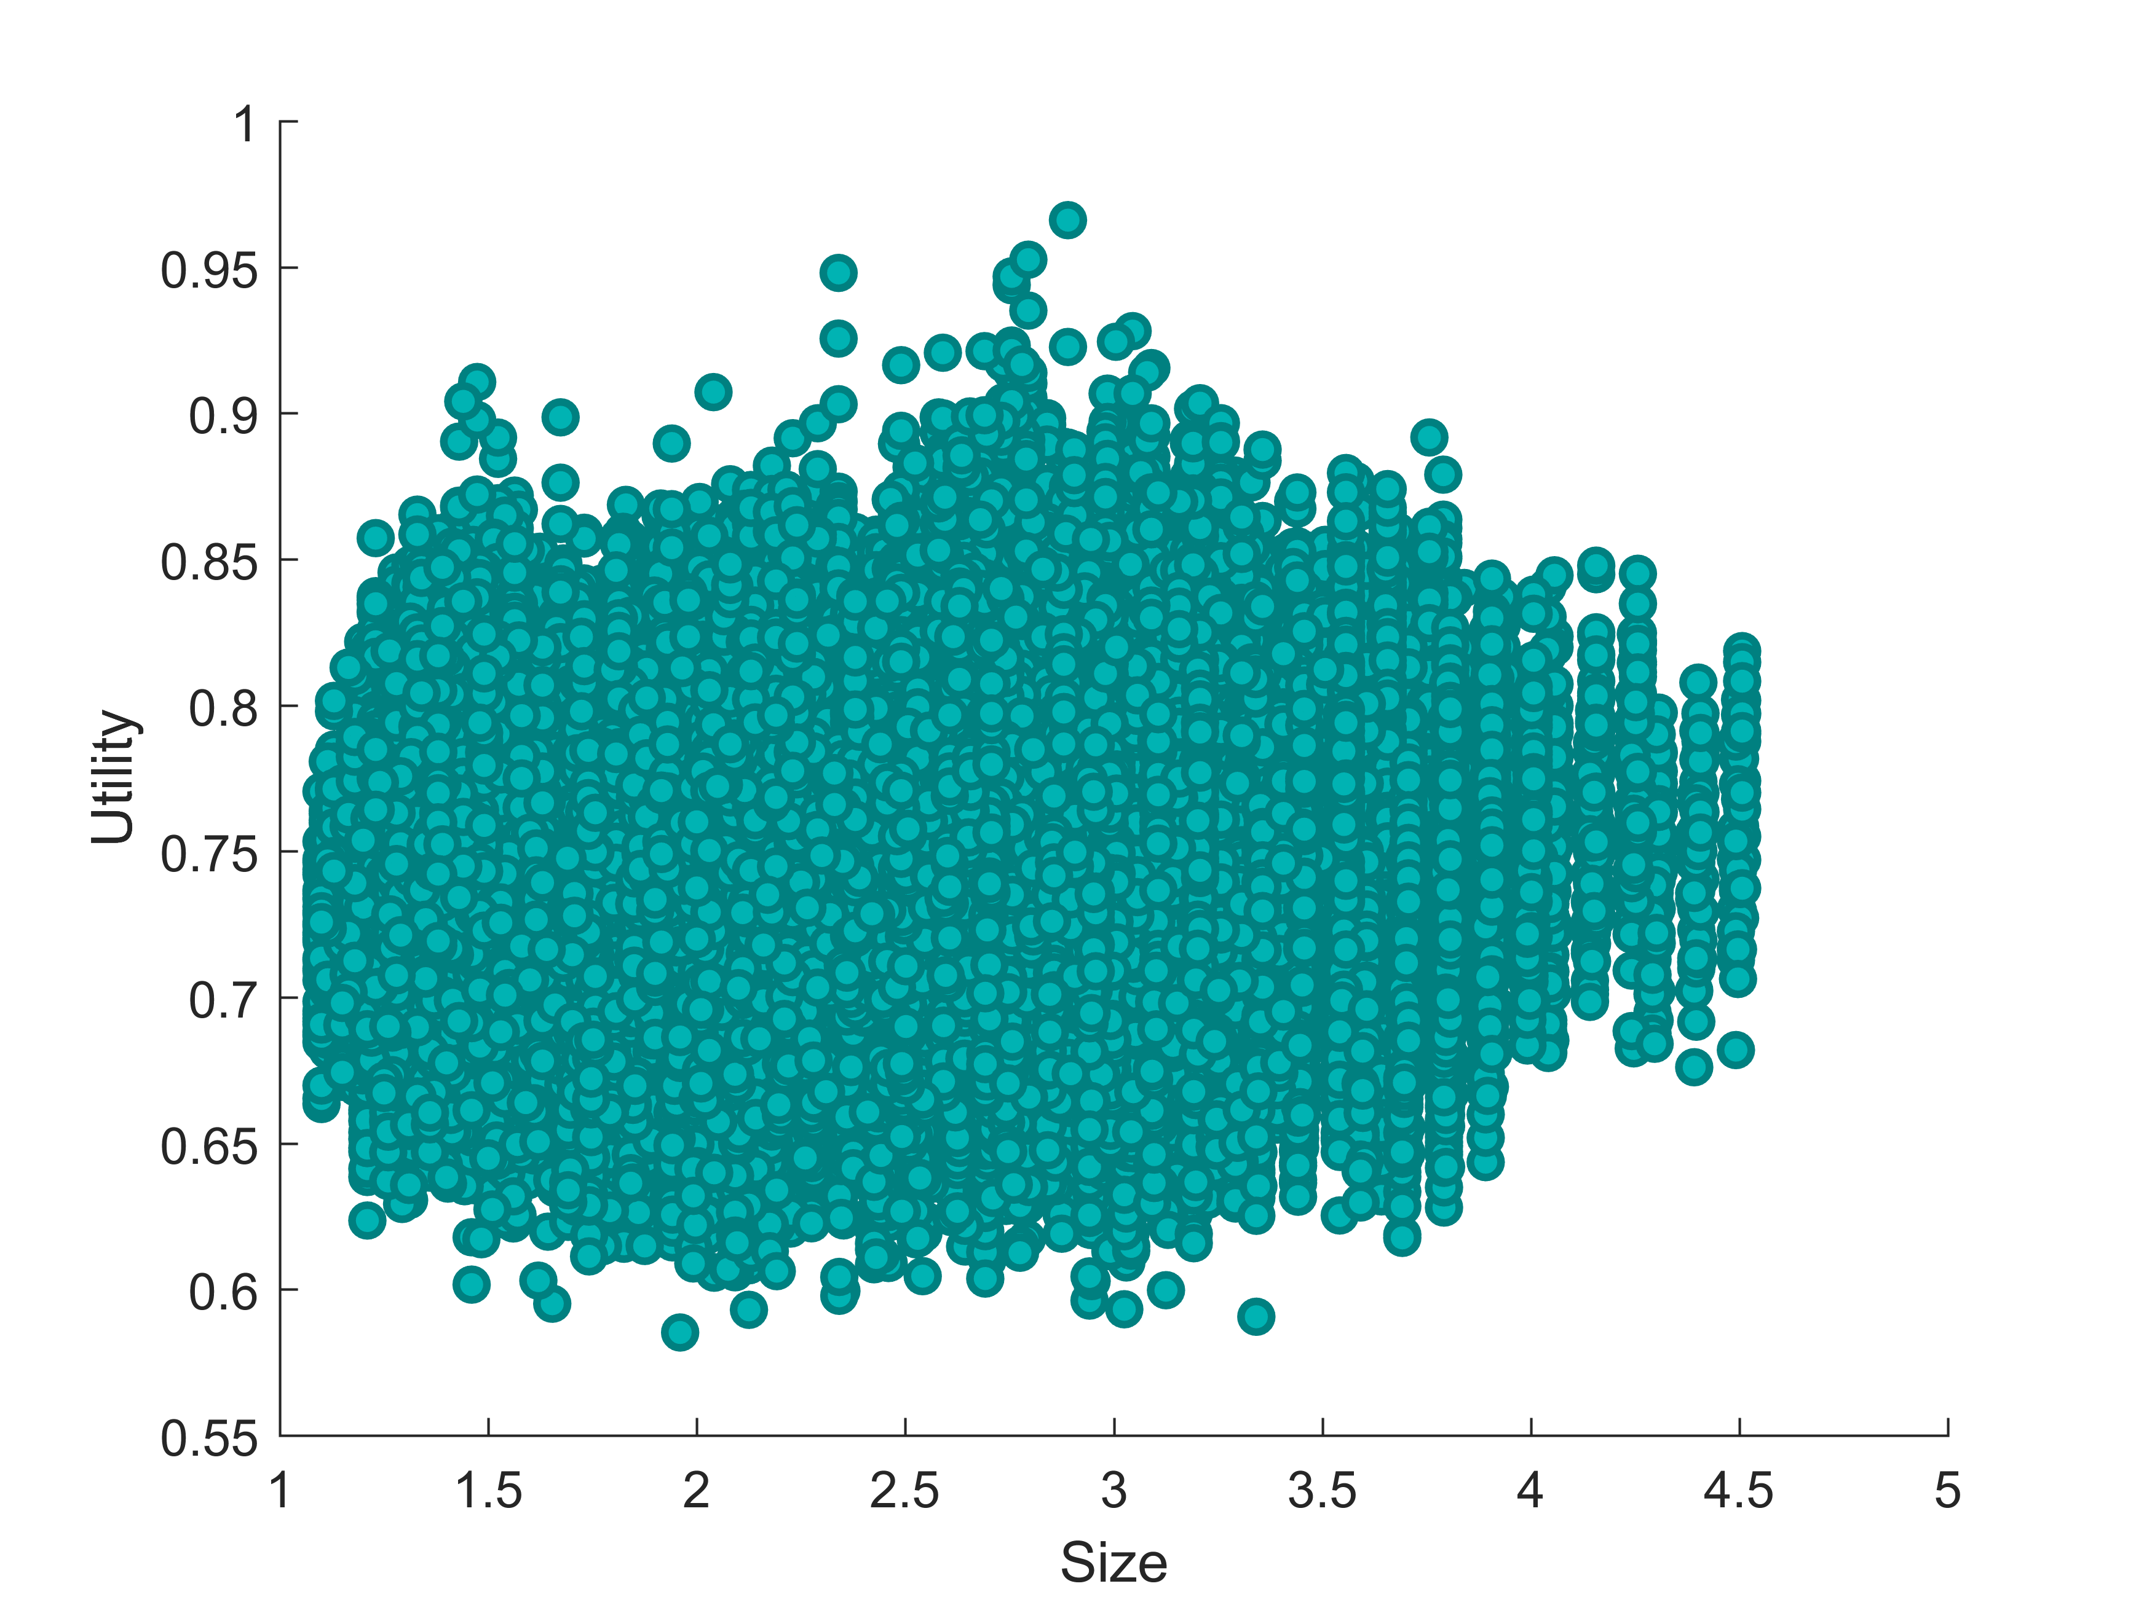
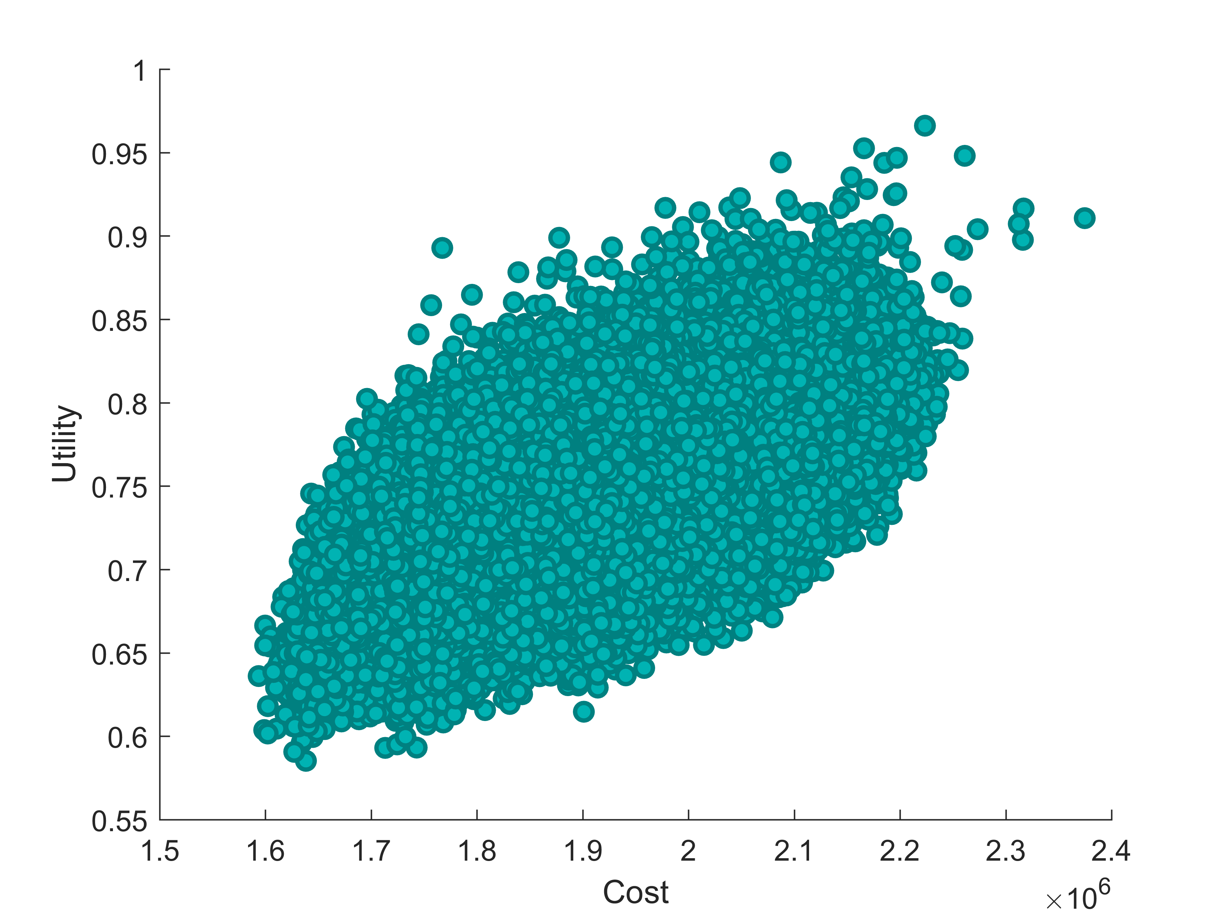
Solution space and Pareto front
22 elements design vector generates a huge space of possible solutions (12+ billions)
Genetic algorithm explores the solution space and converges to the optimal designs.
Downside:
This particular equation setup ‘confuses’ the algorithm, but results are still optimal
Optimization process: evolution in time of the population (image is tilted 90deg anti-clockwise)
Solution cloud (20k points): size, cost and utility are plotted
Solution cloud (1M points): size vs utility
Solution cloud (1M points): cost vs utility

Slide 27
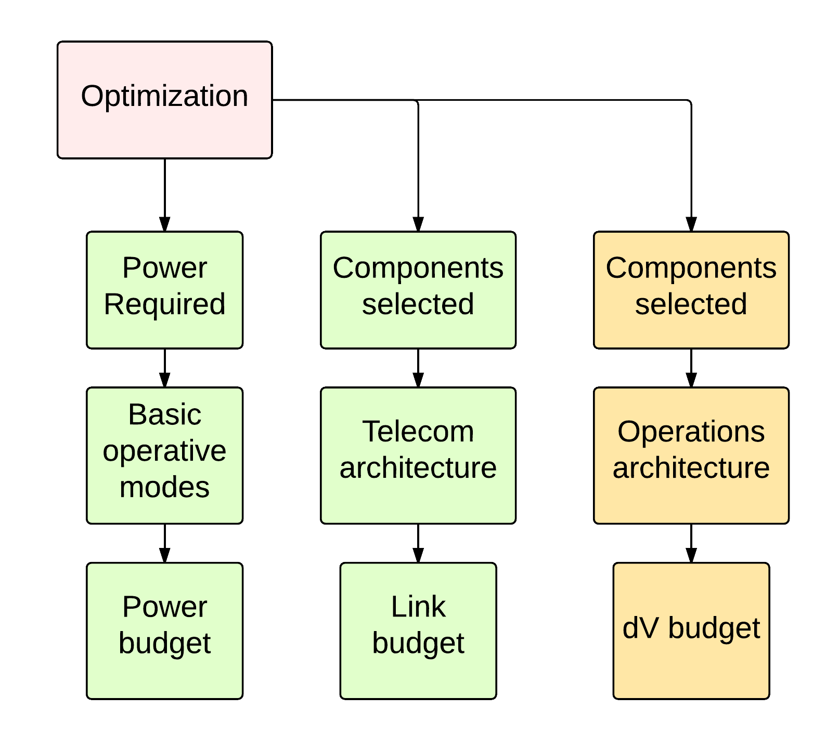
Completing the design I
Solution selection and budgets
Selection of the desired solution for detailed visualization
By utility value, by cost, by size or by power
Design budgets have
been implemented

Slide 28
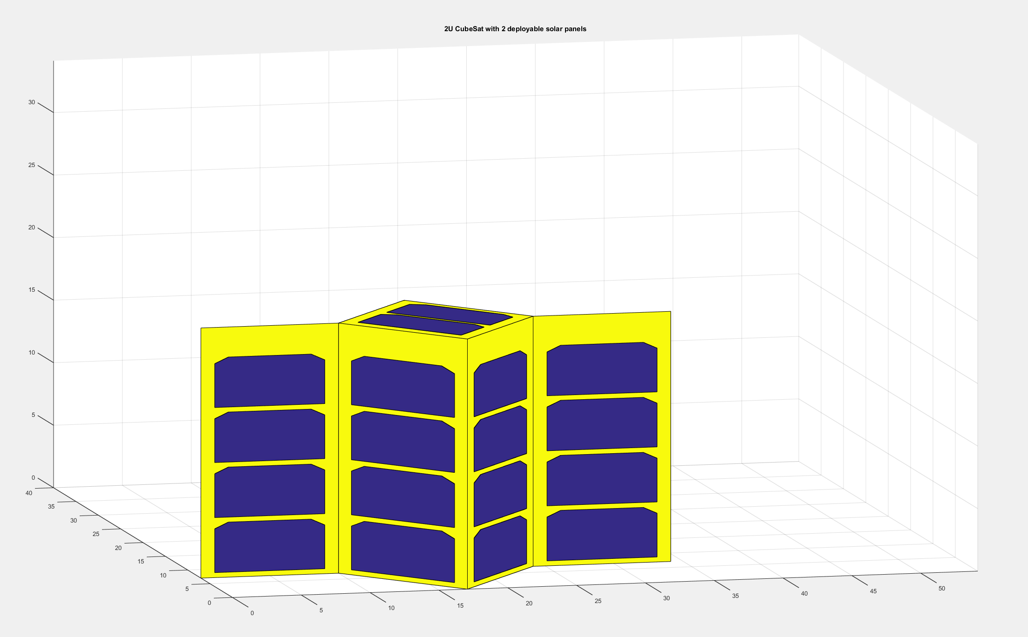
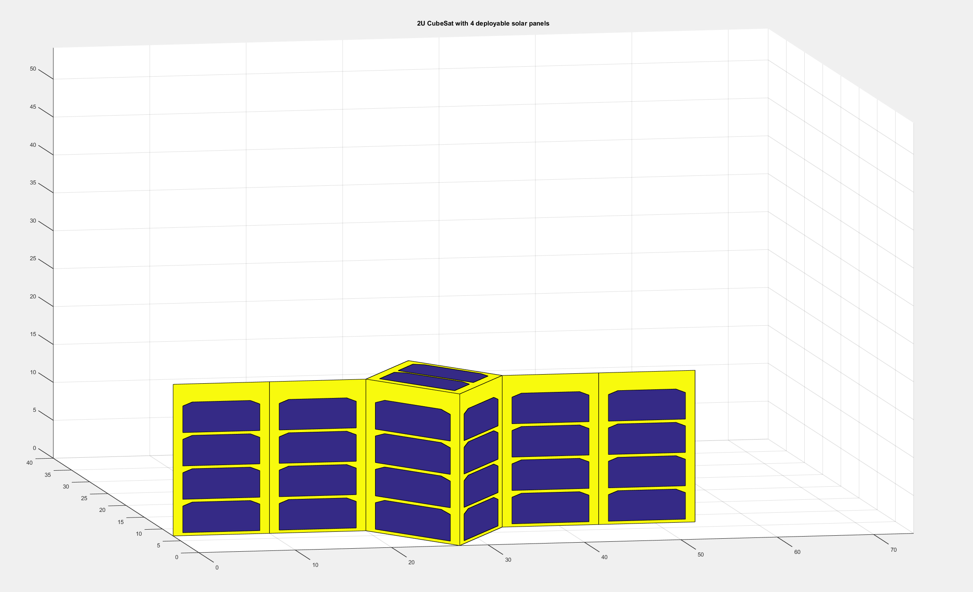
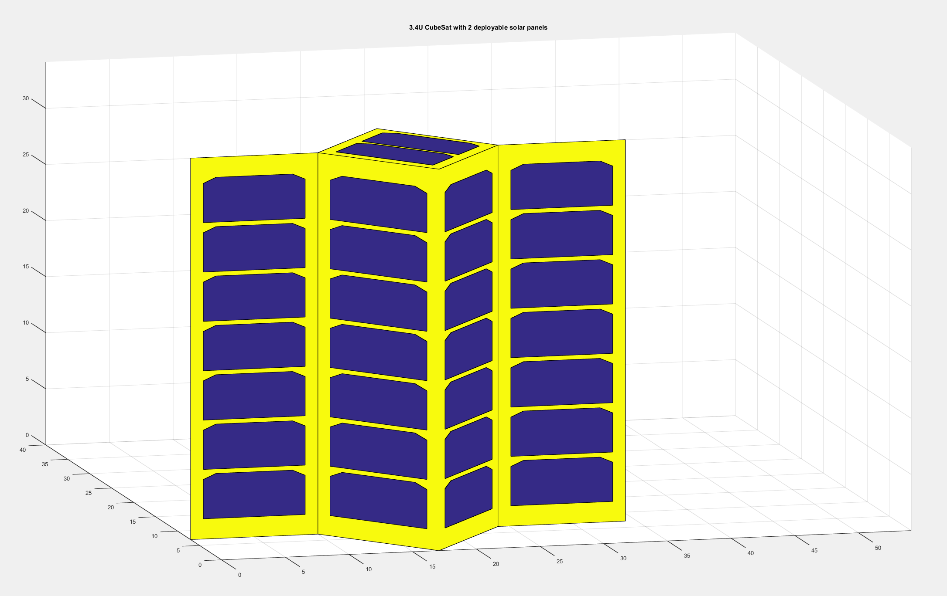
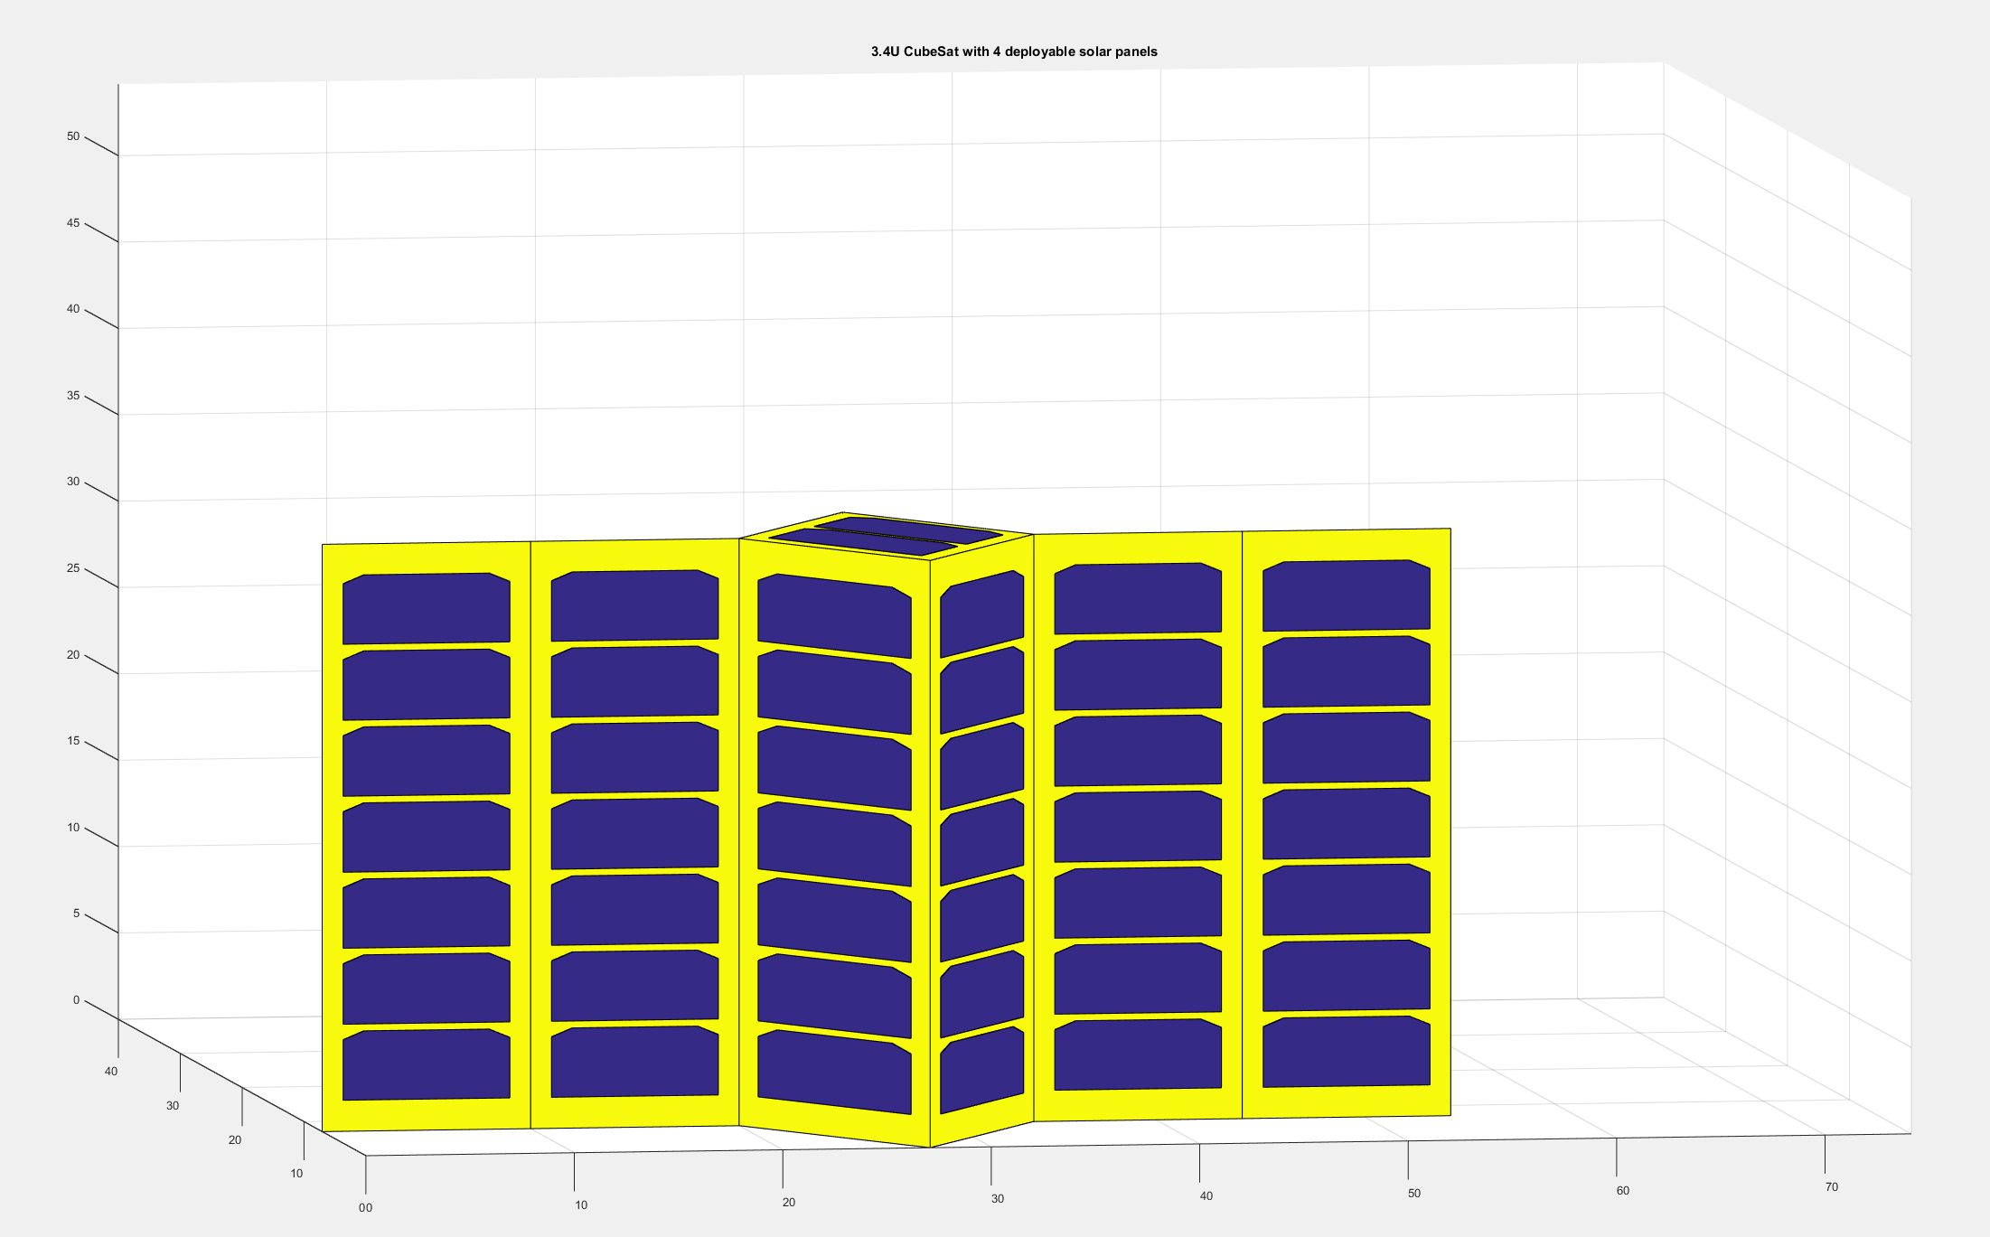
Completing the design II
Configurations - EPS
Power budget is defined once a solution is chosen
Takes into account basic operative modes
Power requirements of all the components
Solar panels sizing and batteries sizing are performed considering the defined power budget and the mission requirements
Solar panels configuration is automatically displayed once the power budget and the sizing is completed
Solar panels configuration: example outputs

Slide 29
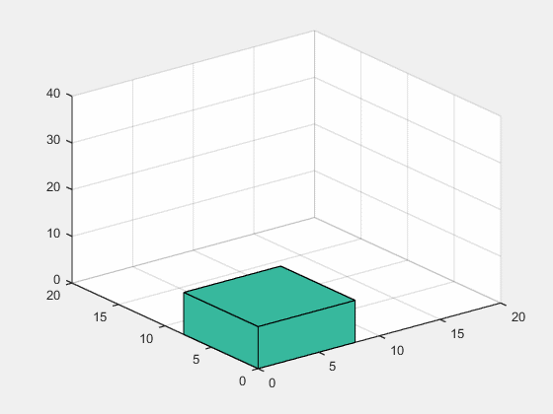
Completing the design III
Configurations – Internal arrangement
The tool allows to visualize the CubeSat internal structure
The boards are represented as parallelepipeds
Algorithm has been developed that tries to assemble the satellite to avoid empty spaces
Takes into account the mounting method (stacked or lateral)
Requirements for equipment positions are applied
It is possible to specify whether an item needs to be located close to an external surface
Optimization output: 3U CubeSat with camera payload

Slide 30
Autonomy
Neural networks for image classification

Slide 31
Payload data selection - Objectives
Use neural networks to implement algorithms that can be applied in the COPINS case study
High level image quality assessment
Event recognition
Necessary activities:
Define the architecture of the network
Prepare the training/testing sets
Prepare the work for future performance evaluation
These algorithms will be evaluated on an embedded processor
Final objective is to construct a Hardware-in-the-Loop simulation with an optical payload

Slide 32
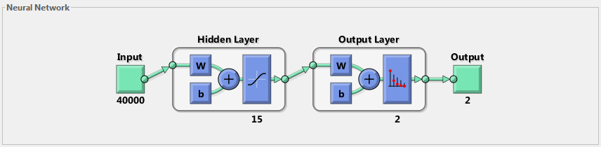
Network Architecture
Originated by emulating biological neurons
Useful for pattern recognition, data classification
Needs to be trained
When properly trained, shows good degrees of robustness and adaptivity
Network architecture for event recognition problem

Slide 33
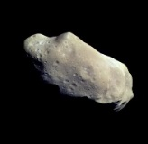
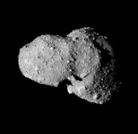
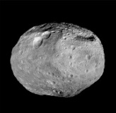
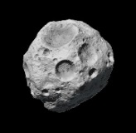



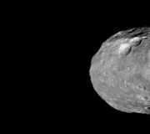
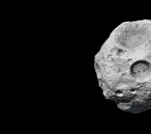
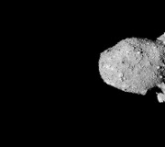
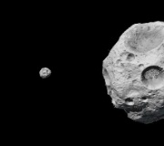
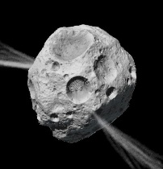
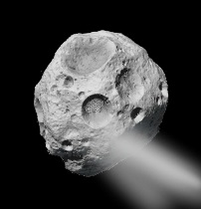
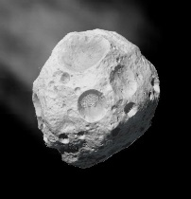
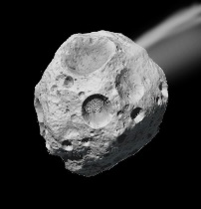
Activity – Payload data selection
COPINS
Neural networks for image recognition
Network trained on asteroid pictures
Tested with different types of asteroid pictures to assess robustness
Backpropagation method
Different architectures explored
Varying the number of neurons, the random range for weights init, learning coefficient, and so on
Different image quality (from 50x50 pixels to 512x512)
Concept of operations is taken into account for training
Algorithm trained to:
Discard low quality photos
Detect random events (plumes appearing, for example)
Training subsets examples: asteroid centered, out of focus image, non centered image, plumes

Slide 34
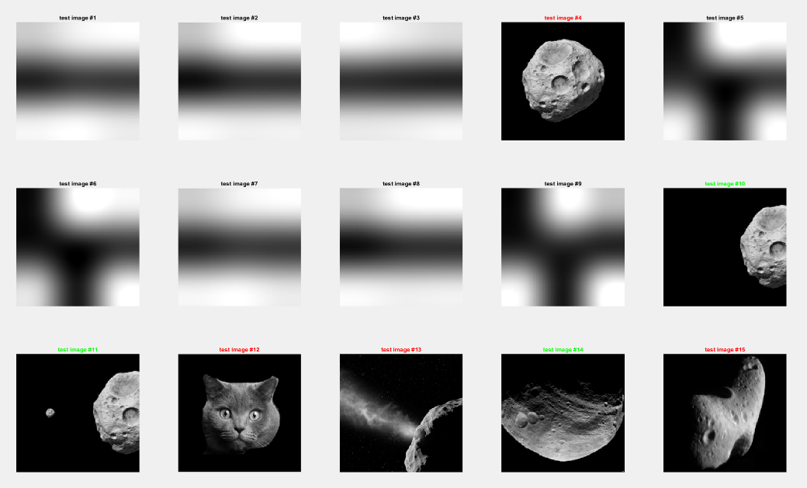
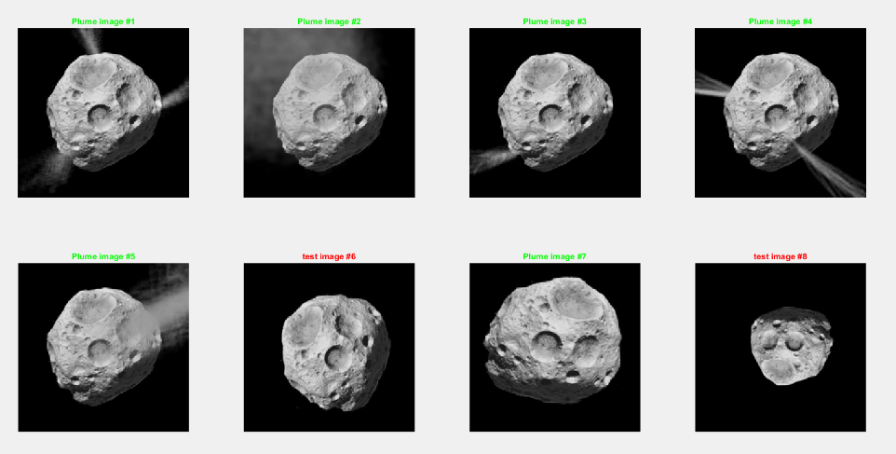
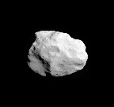
Results obtained – Payload data selection
Different problems were analyzed:
Data selection
Event recognition
The proposed algorithm is sufficiently robust to be used for both the cases, and the results are satisfying.
Improvement can be made by better tuning the network architecture, or by increasing the number of training images.
Images shown in red are interesting because they show particular behavior of the algorithm
Asteroid photo selection
Plume detection

Slide 35
Autonomy
Fuzzy logics for failure detection

Slide 36
Activity – Failure Detection
Autonomous failure detection by means of fuzzy logics
Magnetic torquers failure modeling (clockwise, starting top left): float, lock-in-place, hard-over, loss of efficiency
Definition of fuzzy input and output variables on Matlab: current, d-current, dd-current, error, estimated Loss of Efficiency
RuleViewer for the failure detection: each failure mode has specific traits in the characteristics of the monitored variables. Specific rules have been defined to categorize the failures.
Integration of the FDIR algorithms in the simulations of a 3U CubeSat for GNSS Remote Sensing

Slide 37








Results obtained - Failure Detection
Algorithm is verified: all the failures are correctly detected.
Most difficult to detect is the Loss of Efficiency (due to intrinsic behaviors of the failure), but simple filters allow for a stable identification
Failure detection: four different types of failure are activated in a sequence. Instabilities are due to the fact that sometimes controller command is equal to the failed value.
Algorithm has been tested in the 3STAR CubeSat simulation, developing a fault tolerant attitude control solution
Simulation of the Attitude Control System with failure modes for the Magnetic Torquers

Slide 38
Inflatable Antenna

Slide 39





Inflatable Antenna
Characterizations test for the inflatable antenna prototype
Allows to study different configuration of the inflatable antenna on a CubeSat
1U to 6U are supported
Antenna diameters from 0.5m to 4m
Calculates predicted gains, intertias and volumes
Allows to specify a filling gas
Modeling of the inflatable antenna on MSC Adams
Preparation for the future Small Satellite Dynamic Test-bed tests

Slide 40
Small Satellite Mission
Database

Slide 41




Small Satellite Database

Slide 43





Environment
COPINS mission
Understanding the environment
Simple cases
Stopping from a release of 2m/s
Hohmann transfer from 10km to 5km and 2km
Solar Radiation Pressure effects
Third body problem applies
Calculations on excel, verification on STK
Reference concept of operations
STK simulations: release, Hohmann transfer, 10km orbit, 1km unstable orbit

